Slide 1

30692 Financial Accounting (Module 1 – Session 4)
Academic year 2025-2026
Kasper Regenburg
Assistant Professor of Accounting

Slide 2
Overview
Review of exercises
Beginning year balances
At the end of the accounting period (step 1 – prepare trial balance)
The operation cycle and more on accrual accounting
Revenue and expenses

Slide 3
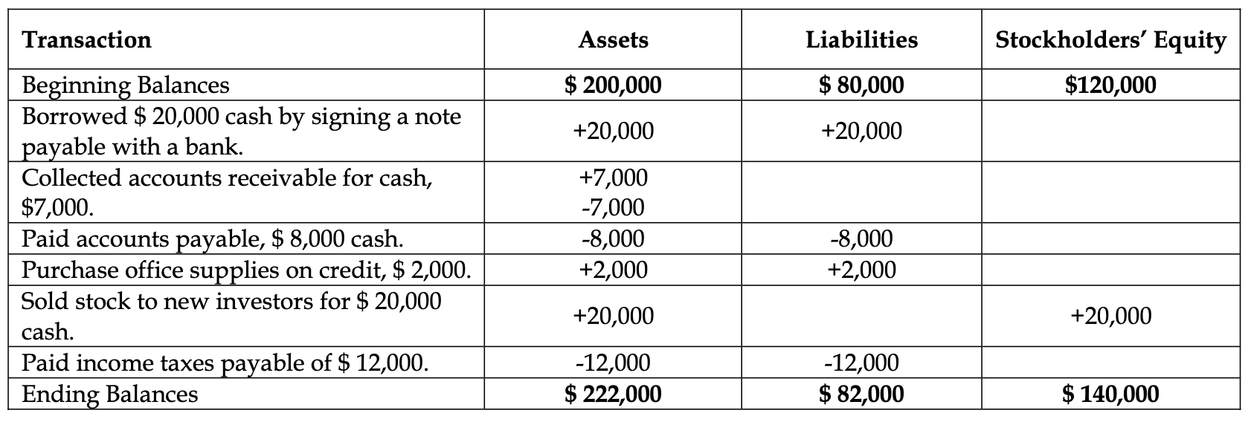
Review exercise 1 for chapter 2

Slide 4
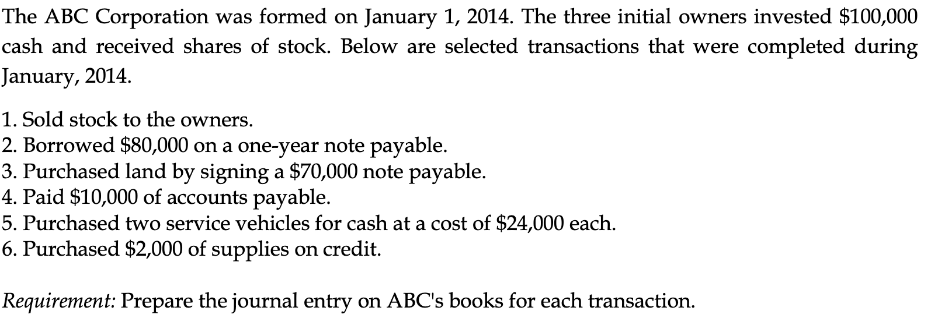
Review of exercise 2 for chapter 2
Notes:
Answers on whiteboard and on Blackboard after class.

Slide 5
Overview
Review of exercises
Beginning year balances
At the end of the accounting period (step 1 – prepare trial balance)
The operation cycle and more on accrual accounting
Revenue and expenses

Slide 6
Beginning of year balances
Asset accounts |  |  |  |  |  | Equity and liab. accounts
Cash |  |  |  |  |  | Common stock
Debit |  |  | Credit |  |  | Debit |  |  | Credit
925 | (1/1-25) |  |  |  |  |  |  | 800 | (1/1-25)
Inventory |  |  |  |  |  | Accounts payable
Debit |  |  | Credit |  |  | Debit |  |  | Credit
225 | (1/1-25) |  |  |  |  |  |  | 500 | (1/1-25)
Property, plant, and equipment |  |  |  |  |  | Salaries payable
Debit |  |  | Credit |  |  | Debit |  |  | Credit
450 | (1/1-25) |  |  |  |  |  |  | 300 | (1/1-25)

Slide 7
Beginning of year balances
Asset accounts |  |  |  |  |  | Equity and liab. accounts
Cash |  |  |  |  |  | Common stock
Debit |  |  | Credit |  |  | Debit |  |  | Credit
925 | (1/1-25) | 200 | (1) |  |  |  |  | 800 | (1/1-25)
200 | (4) | 150 | (2)
 |  | 160 | (3)
Inventory |  |  |  |  |  | Accounts payable
Debit |  |  | Credit |  |  | Debit |  |  | Credit
225 | (1/1-25) |  |  |  |  | 200 | (1) | 500 | (1/1-25)
150 | (2)
Property, plant, and equipment |  |  |  |  |  | Salaries payable
Debit |  |  | Credit |  |  | Debit |  |  | Credit
450 | (1/1-25) | 200 | (4) |  |  | 160 | (3) | 300 | (1/1-25)

Slide 8
Beginning of year balances
Debit: 615 + 375 + 250 = 1240
Credit: 800 + 300 + 140 = 1240
Asset accounts |  |  |  |  |  | Equity and liab. accounts
Cash |  |  |  |  |  | Common stock
Debit |  |  | Credit |  |  | Debit |  |  | Credit
925 | (1/1-25) | 200 | (1) |  |  |  |  | 800 | (1/1-25)
200 | (4) | 150 | (2)
 |  | 160 | (3)
615 |  |  |  |  |  |  |  | 800
Inventory |  |  |  |  |  | Accounts payable
Debit |  |  | Credit |  |  | Debit |  |  | Credit
225 | (1/1-25) |  |  |  |  | 200 | (1) | 500 | (1/1-25)
150 | (2)
375 |  |  |  |  |  |  |  | 300
Property, plant, and equipment |  |  |  |  |  | Salaries payable
Debit |  |  | Credit |  |  | Debit |  |  | Credit
450 | (1/1-25) | 200 | (4) |  |  | 160 | (3) | 300 | (1/1-25)
250 |  |  |  |  |  |  |  | 140

Slide 9
Trial balance
Debit: 615 + 375 + 250 = 1240
Credit: 800 + 300 + 140 = 1240
Company A – Unadjusted Trial Balance Dec 31, 2025 (in millions of euros) | Debit | Credit
Cash | 615
Inventory | 375
Property, plant, and equipment | 250
Salaries payable |  | 140
Accounts payable |  | 300
Common stock |  | 800
Total | 1240 | 1240

Slide 10
Small exercise
Duration: 12 min
With?: Alone or in pairs
Objective: Recording transactions and preparing an unadjusted trial balance.
Open and solve:
Blackboard page → Extra materials → Session 4 exercise.

Slide 11
Small exercise
Duration: 6 min
With?: In pairs
Objective: Reviewing recorded transactions and an unadjusted trial balance.
Open the guiding solutions and review the answers of one of your co-students next to you:
Blackboard page → Extra materials → Session 4 exercise.

Slide 12
Overview
Review of exercises
Beginning year balances
At the end of the accounting period (step 1 – prepare trial balance)
The operation cycle and more on accrual accounting
Revenue and expenses

Slide 13
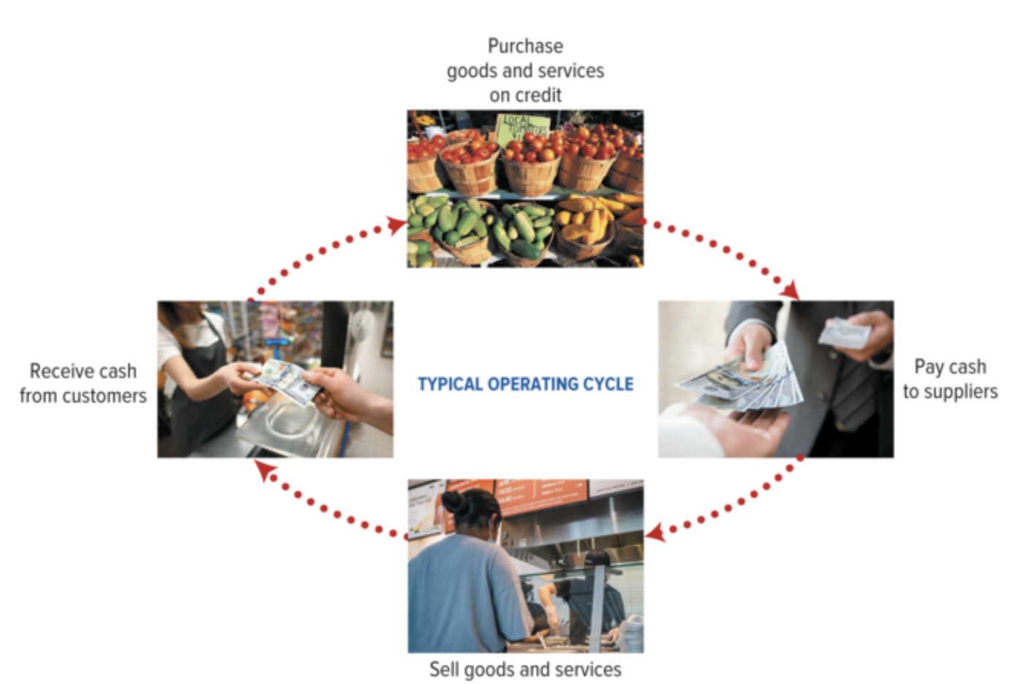
The operating cycle

Slide 14
The operating cycle: Accrual accounting
Last year 2023
This year 2024
Next year 2025
10
10
20
20
Revenue = 20
Expenses = 10
Income statement
Net income = 20 - 10 = 10
Cash = -10 + 20 = 10
= Receives goods from supplier
= Payment to supplier
= Sells product to customer
= Receives cash from customer
Notes:
Notice that with these expenses, we strictly assume that they are the only one. We will expand this later.

Slide 15
The operating cycle: Accrual accounting
Last year 2023
This year 2024
Next year 2025
10
10
20
20
10
10
20
20
Revenue = 2 x 20= 40
Expenses = 2 x 10 = 20
Net income = 40 - 20 = 20
Cash = -10 + 20 – 10 = 0
= Receives goods from supplier
= Payment to supplier
= Sells product to customer
= Receives cash from customer

Slide 16
The operating cycle: Accrual accounting
Last year 2023
This year 2024
Next year 2025
10
10
20
20
10
10
20
20
10
10
20
20
Revenue = 2 x 20 = 40
Expenses = 2 x 10 = 20
Revenue = 20
Net income = 40 - 20 = 20
Expenses = 10
Cash = -10 + 20 – 10 = 0
Net income = 10
Inventory = 10
Accounts payable = 10
Cash = 20 + 20 – 10 = 30
= Receives goods from supplier
= Payment to supplier
= Sells product to customer
= Receives cash from customer

Slide 17
The operating cycle: Accrual accounting
Last year 2023
This year 2024
Next year 2025
Revenue = 3 x 20 = 60
10
10
20
20
Expenses = 3 x 10 = 30
Net income = 60 – 30 = 30
10
10
20
20
Cash = 4 x 20 – 3 x 10 = 50
10
10
20
20
Revenue = 2 x 20 = 40
10
10
20
20
Expenses = 2 x 10 = 20
Net income = 40 - 20 = 20
10
10
20
20
Cash = -10 + 20 – 10 = 0
Inventory = 10
Accounts payable = 10
10
10
20
20
= Receives goods from supplier
= Payment to supplier
= Sells product to customer
= Receives cash from customer

Slide 18
The operating cycle: Accrual accounting
Last year 2023
This year 2024
Next year 2025
20
10
20
10
Deferred revenue (L) = 20
Accounts payable (L) = 10
Accounts payable (L) = 0
Cash (A) = 20
Revenue = 20
Cash (A) = 10
Expenses = 10
Net income (SE)= 20 - 10 = 10
Deferred revenue (L) = 0
Cash (A) = 20
= Receives goods from supplier
= Payment to supplier
= Sells product to customer
= Receives cash from customer
Notes:
Example of deferred revenue.

Slide 19
Accrual accounting
 | Asset account | Liability account
Cash flow before revenue or expense incurs | Deferred expense Cash outflow in period t Expense in period t+1 Examples: Prepaid rent or insurance Property, plant, and equipment (which we depreciate) | 2) Deferred revenue Cash inflow in period t Revenue in period t+1 Examples Prepaid revenue (when a customers pays before in advance). Gift cards Rental collected in advance
Cash flow after revenue or expense incurs | 3) Accrued asset Revenue in period t Cash inflow in period t+1 Examples: Accounts receivable Other receivables | 4) Accrued liability Expense in period t Cash outflow in period t+1 Examples: Payroll, utilities, taxes (certain payments)
t = current year, t+1 = next year

Slide 20
Small exercise
Duration: 5 min
With?: Alone or in pairs
Objective: Determine the revenue, expense, income, and cash effect of operation transactions.
Bananas Consulting Group (BCG) receive a prepayment of $14,520 for services that they expect to provide early next fiscal year.
BCG provide consulting services worth $17,400 for the client McHansy. McHansy pay half now and defer the rest of the payment to the next month.
The total sum of wages to the BCG consultants for the McHansy delivery is $8.900. The consultants have not received their salaries yet.
Record the journal entries and show the T-accounts for BCG.

Slide 21
Overview
Review of exercises
Beginning year balances
At the end of the accounting period (step 1 – prepare trial balance)
The operation cycle and more on accrual accounting
Revenue and expenses

Slide 22
Revenue
Definition:
Inflows or other enhancements of assets of an entity or settlements of its liabilities (or a combination of both) from delivering or producing goods, rendering services, or other activities that constitute the entity's ongoing major or central operations.
Order in the income statement: Core revenue(s) at the top, other revenue in ”other income”.
Notes:
Linked to assets and liabilities, so it thus also have to be measurable.

Slide 23
Revenue recognition principle model
Identify the contract (written, verbal, or implied agreement) between the company and customer.
Identify the seller’s performance obligations (promised goods and services)
Determine the transaction price (the amount the seller expects to be entitled to receive from the customer).
Allocate the transaction price to the performance obligations.
Recognize revenue when each performance obligation is satisfied (or over time if a service is provided over time).

Slide 24
Expenses
Definition:
Outflows or other using up of assets or incurrences of liabilities (or a combination of both) from delivering or producing goods, rendering services, or carrying out other activities that constitute the entity’s ongoing major or central operations.
Order in the income statement: Operating section: Typically ordered how closely the expense varies with the revenue. Other section, sometimes with financial items grouped, and taxes.

Slide 25
Expenses
Examples
Cost of goods sold/cost of sales,
Salary expense,
Rent expense,
Other operating expenses,
Income tax expense,
Depreciation expense, and
Interest expenses.
Notes:
Read page 113-114 of the book for a list of Chipotle’s expenses

Slide 26
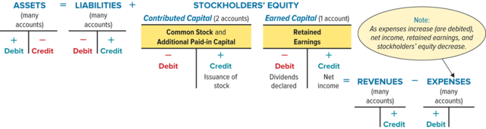
Expanding the debit and credit accounts

Slide 27
Expanding the debit and credit accounts

Slide 28
Small exercise
Duration: 5 min
With?: Alone or in pairs
Objective: Record sales revenue and cost of goods sold.
Record the journal entries and show the T-accounts for Brew & Bean Supplies Inc.
On January 1, the owners of Brew & Bean Supplies inc. contribute $3,500 in cash in exchange for common stock.
On January 2, Brew & Bean buy 100 bags of Colombian coffee beans from its supplier at $20 each on credit.
On January 5, Brew & Bean sell 40 bags of beans to Café Aroma at $35 each, cash payment.
On January 12, Brew & Bean sell 25 bags to JavaHouse for $40 each, but on 30-day credit.

Slide 29
For next time
Skim chapter 4
We will later read it in full

